Slide 1

PROJECT-BASED LEARNING
PHASE-III FINAL EVALUATION
RESQ — Intelligent Disaster Rescue
& Emergency Response Simulator
“Algorithms That Save Lives.”
Team ID: DSCPP-III-2026-T117
Department of Computer Science & Engineering
Graphic Era (Deemed to be University), Dehradun
Academic Session 2026–27

Slide 2
Team & Mentor Details
Team Information
Team Members
Team ID: DSCPP-III-2026-T117
Semester: 3rd
Sections: DS-2, ML-1, ML-2, ML-4
Domain: Data Structures & OOP (C/C++)
1. Vanya Rathi — 2510383410 (DS-2, Lead)
2. Akshat Dobhal — 2510370353 (ML-2)
3. Ayush Kandwal — 2510380235 (ML-4)
4. Nitin Singh — 2510370229 (ML-1)
Mentor
Dr. Prabhdeep Singh Interactions completed: 02
Technical Responsibilities
Vanya: architecture and integration | Akshat: data structures | Ayush: graph routing | Nitin: C++ classes and testing
Department of Computer Science & Engineering | Graphic Era (Deemed to be University)
2/18

Slide 3
Project Abstract & Problem Statement
Project Abstract
RESQ organises simulated rescue calls by severity, checks whether locations are reachable and finds low-cost routes through a disaster map. The final submission includes a native C/C++ simulator and a separate browser demo with a map and operations dashboard.
Problem Statement
During a disaster, many calls can arrive together while roads become slow or blocked. A simple arrival-only list may delay a critical case, and a route chosen without checking the current map may not be usable.
Target Users / Application
Students learning how queues, heaps and graph algorithms behave in one workflow.
Classroom demonstrations of triage, dispatch and hospital-transfer decisions.
A safe basis for experimentation without connecting to real emergency systems.
Department of Computer Science & Engineering | Graphic Era (Deemed to be University)
3/18

Slide 4
Objectives & Final Deliverables
Finalized Objectives
Final Deliverables
Record victim and disaster details.
Serve critical cases before routine calls.
Detect unreachable locations after road blocks.
Calculate efficient open routes with Dijkstra.
Track units, hospitals, outcomes and history.
Working native C/C++ earthquake simulation.
Interactive browser map and operations dashboard.
Simplified source, Makefile, README and sample output.
Phase-I, Phase-II and Phase-III documentation.
GitHub repository and live demonstration link.
Scope: a demonstrable classroom prototype, not a certified emergency-response product.
Department of Computer Science & Engineering | Graphic Era (Deemed to be University)
4/18

Slide 5
Phase-I & Phase-II Feedback Incorporated
Review Stage | Review Focus | Action We Took
Phase-I team review | Connect every DSA topic to a clear rescue task. | Mapped records, queues, stack, BFS and Dijkstra to named modules.
Phase-I team review | Account for roads that may become unusable. | Added blocked edges, changed weights and an unresolved outcome.
Phase-II team review | Make the running logic easier to follow in a demo. | Added the browser map, visible queue and operations dashboard.
Phase-II team review | Make the source easier to explain and maintain. | Simplified the native code into five main source files; output stayed unchanged.
Final Improvement
The project moved from a paper design to a repeatable native scenario and a visual demonstration. These points summarise our own phase reviews; they are not quoted evaluator comments.
Department of Computer Science & Engineering | Graphic Era (Deemed to be University)
5/18

Slide 6
Final System Architecture
Calls &
disaster input
Victim
records
FIFO queue &
critical max-heap
BFS &
Dijkstra
Rescue &
hospital result
Major Components
System Flow
C record, queue, heap, stack and graph modules.
C++ victims, units, hospitals and operations.
Native text output and saved mission summary.
Separate React/TypeScript visual demonstration.
A call enters the queue selected by severity.
BFS checks access before any unit is assigned.
Dijkstra compares routes and travel costs.
Status, beds and history update after dispatch.
Storage boundary: native records use program data structures; browser records are session-only. No external database.
Department of Computer Science & Engineering | Graphic Era (Deemed to be University)
6/18

Slide 7
Final Technology Stack
Software / Technologies
Development Infrastructure
Native programming: C11 and C++17.
Browser demo: TypeScript, React and SVG.
Data storage: in-memory records; no DBMS.
Documentation: LaTeX and Overleaf.
Platforms: desktop terminal and modern browsers.
Build: GCC, G++ and Make.
Version control: Git and GitHub, main branch.
Validation: warning flags and saved-output comparison.
Browser deployment: Lovable.
Evidence: sample output, screenshots and test tables.
C handles data structures directly; C++ organises rescue resources and operations. The web layer is a separate demonstration.
Department of Computer Science & Engineering | Graphic Era (Deemed to be University)
7/18

Slide 8
Implementation of PBL Course Concepts
Course | Concepts Actually Implemented | Project Module
Data Structures in C | Singly linked list; circular FIFO queue; binary max-heap; stack; weighted graph; BFS; Dijkstra; insertion sort; quick sort; binary and linear search. | Victim records, triage, operation history, map routing and record inspection.
OOPs with C++ | Encapsulation; constructors and destructors; inheritance; virtual functions and runtime polymorphism; class composition. | Location, Victim, RescueUnit, RescueTeam, Ambulance, Hospital, Disaster and RescueOperation.
Direct Demonstration
The terminal output shows critical-first heap dispatch, BFS reachability, Dijkstra paths, latest-first stack history and polymorphic describe() calls for teams and ambulances.
Department of Computer Science & Engineering | Graphic Era (Deemed to be University)
8/18

Slide 9
Module-Wise Final Implementation
Module | Implementation | Responsible | Status
Records & queues | Linked victim records, FIFO routine queue, critical max-heap and history stack. | Akshat Dobhal | Completed
Graph & routing | Weighted map, road blocks, BFS reachability and Dijkstra route selection. | Ayush Kandwal | Completed
Resources & testing | C++ resource classes, hospitals, dispatch operations and scenario checks. | Nitin Singh | Completed
Integration & demo | Triage flow, native integration, browser demonstration and documentation. | Vanya Rathi | Completed
Planned classroom prototype scope: 100% complete. Future enhancements are not counted as pending modules.
Department of Computer Science & Engineering | Graphic Era (Deemed to be University)
9/18

Slide 10
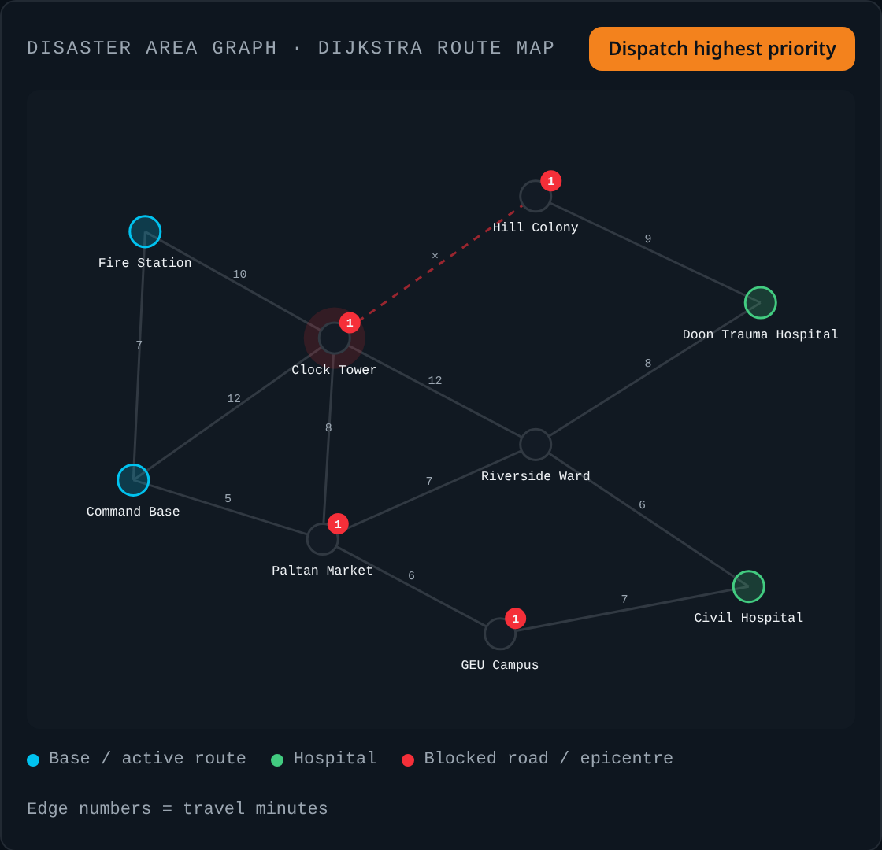
Working System / Prototype Demonstration
Major Working Features
Browser Demonstration — Route Map
Victim registration with severity and location.
Earthquake, flood, fire and accident settings.
Live priority order and blocked-road display.
Dijkstra route drawing and rescue dispatch.
Dashboard filters and completed-rescue counts.
Live demo: rescue-bot-pro.lovable.app
The native terminal demo shows the corresponding C/C++ implementation; the browser demo is separate.
Department of Computer Science & Engineering | Graphic Era (Deemed to be University)
10/18

Slide 11
Data / Database / Backend Implementation
Data / Storage
Backend / Core Logic
No external database or live disaster dataset.
Native victim records are held in a linked list.
Fixed arrays describe locations, roads and resources.
Entities: Victim, Location, RescueUnit, Hospital and Disaster.
Browser records remain in memory for the current session.
Native processing is performed by the C/C++ executable.
Max-heap and FIFO queues control dispatch order.
BFS and Dijkstra handle reachability and routing.
Hospital capacity and trauma requirements are checked.
No login, remote API or real emergency connection.
An unreachable request remains unresolved and is flagged for air support; it is never reported as a successful road rescue.
Department of Computer Science & Engineering | Graphic Era (Deemed to be University)
11/18

Slide 12
Testing & Validation
Test Type | Expected Result | Observed Result | Status
Build check | Clean C11/C++17 build. | GCC/G++ completed with warning flags and no warnings. | Pass
Priority dispatch | RED severity 9, 8, 7 before routine calls. | All three critical cases dispatched first. | Pass
BFS reachability | Cut-off location detected after road block. | 9 of 10 reachable; Hill Colony left unresolved. | Pass
Dijkstra routes | Correct costs on the fixed weighted map. | Paltan Bazaar 7; Doon Trauma Centre 13 simulated minutes. | Pass
Full system test | Calls, units, hospitals and summary stay consistent. | 7 logged, 6 rescued, 1 unreachable, 4 units deployed. | Pass
Regression test | Simplification must not change behaviour. | Fresh output matched saved sample byte for byte. | Pass
These checks prove repeatable behaviour in our fixed earthquake scenario — not real-world performance or medical validation.
Department of Computer Science & Engineering | Graphic Era (Deemed to be University)
12/18

Slide 13
Results & Performance Analysis
Key Results
Fixed Earthquake Scenario — Call Outcomes
7 emergency calls processed in the native scenario.
6 victims rescued; 1 unreachable case kept waiting.
4 resources deployed; average response 17 simulated minutes.
BFS reached 9 of 10 locations after the road block.
Fresh output matched the saved sample exactly.
7
6
1
Logged
Rescued
Unreachable
All times and counts come from simulated input, not live emergency data.
Department of Computer Science & Engineering | Graphic Era (Deemed to be University)
13/18

Slide 14
GitHub Repository & Development Evidence
Repository Details
Development Evidence
Repository: RESQ-disaster-response-simulator
Branch: main
Code/: source, Makefile, README and sample output.
Phase 1/ and Phase 2/: earlier documents.
Owner: github.com/akshat017-beep
Original and simplified native source packages retained.
Saved output supports repeatable regression checking.
Repository history is available for evaluator inspection.
Reports and presentations are included as project evidence.
Shared uploads are not presented as individual commit counts.
Open the GitHub repository
Repository transparency: module ownership is documented separately from the shared GitHub upload history.
Department of Computer Science & Engineering | Graphic Era (Deemed to be University)
14/18

Slide 15
Individual Contribution
Member | Role | Final Technical Contribution | Commits
Vanya Rathi | Team lead, DS-2 | Architecture, triage logic, integration, browser coordination and final documentation. | Shared history
Akshat Dobhal | DSA modules, ML-2 | Linked list, FIFO queue, binary max-heap and operation-history stack. | Shared history
Ayush Kandwal | Routing, ML-4 | Weighted graph, BFS reachability and Dijkstra route planning. | Shared history
Nitin Singh | OOP & testing, ML-1 | C++ resource classes, scenario testing, dashboard and reports. | Shared history
Each member can explain the assigned module. Shared commits are not converted into invented individual commit totals.
Department of Computer Science & Engineering | Graphic Era (Deemed to be University)
15/18

Slide 16
Challenges, Limitations & Lessons Learned
Challenges & Solutions
Technical Learning
Equal priorities — preserve earlier-call order.
Blocked roads — check BFS reachability before dispatch.
Limited beds — update hospital capacity after transfer.
C/C++ boundary — simplify interfaces and verify output.
A heap changes who is helped first, not just how data is stored.
BFS answers reachability; Dijkstra answers route cost.
Virtual functions give different resources one interface.
Output comparison is useful during refactoring.
Current Limitations
Team Learning
Fixed sample data; no GPS, medical protocol or emergency API.
Browser state is temporary and separate from the native program.
Clear module ownership made integration easier.
Honest unresolved cases are better than false success messages.
Department of Computer Science & Engineering | Graphic Era (Deemed to be University)
16/18

Slide 17
Final Outcomes, Applications & Future Scope
Final Outcomes
Applications
Future Scope
Complete native rescue-flow demonstration.
Interactive map and dashboard.
Repeatable test output and clear source modules.
Final reports, slides and repository.
DSA and OOP classroom teaching.
Algorithm comparison on disaster maps.
Demonstrating triage and resource constraints.
A base for future student experiments.
More scenarios and saved data.
One shared native/web algorithm core.
Compare priority dispatch with FIFO.
Expert-guided real-world requirements study.
Tangible Project Outcome
A working native C/C++ prototype plus a separate browser demonstration. RESQ remains an educational simulator, not a deployable emergency service.
Department of Computer Science & Engineering | Graphic Era (Deemed to be University)
17/18

Slide 18
References & Project Resources
References
Project Resources
Cormen et al., Introduction to Algorithms, 4th ed., MIT Press, 2022 — heaps, BFS and shortest paths.
E. W. Dijkstra, “A note on two problems in connexion with graphs,” Numerische Mathematik, 1, 269–271, 1959.
B. Stroustrup, The C++ Programming Language, 4th ed., 2013.
Kernighan and Ritchie, The C Programming Language, 2nd ed., 1988.
NDMA, India — background guidance only; RESQ is not an approved emergency tool.
GitHub: RESQ-disaster-response-simulator
Live demo: rescue-bot-pro.lovable.app
Dataset: fixed classroom scenario; no external dataset.
Documentation: Phase-I, Phase-II and Phase-III reports and presentations.
Open GitHub
Open live demo
Thank You
Questions & Discussion
Department of Computer Science & Engineering | Graphic Era (Deemed to be University)
18/18

